Slide 1
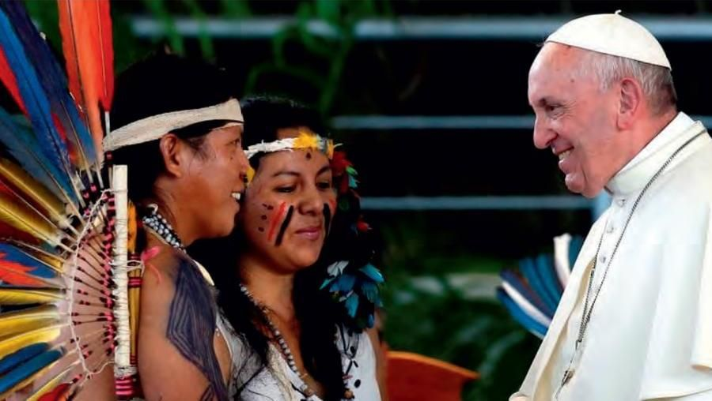
BELOVED AMAZON

Slide 2
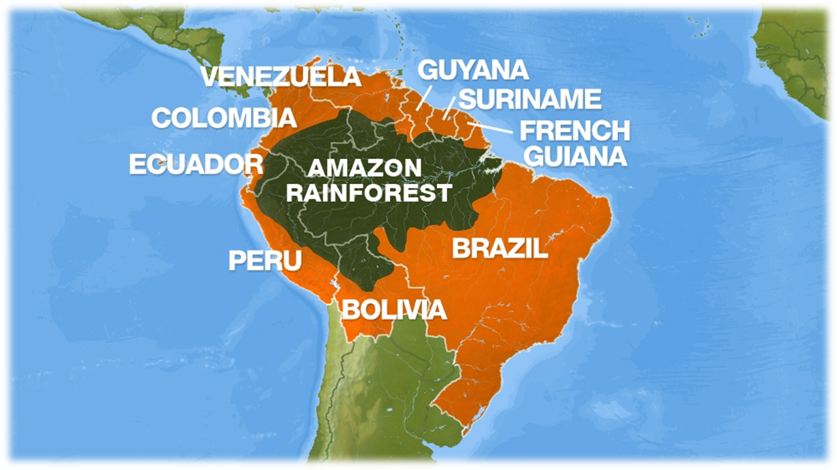
The beloved Amazon region stands before the world
in all its splendour, its drama and its mystery.
QUERIDA AMAZONIA 1

Slide 3
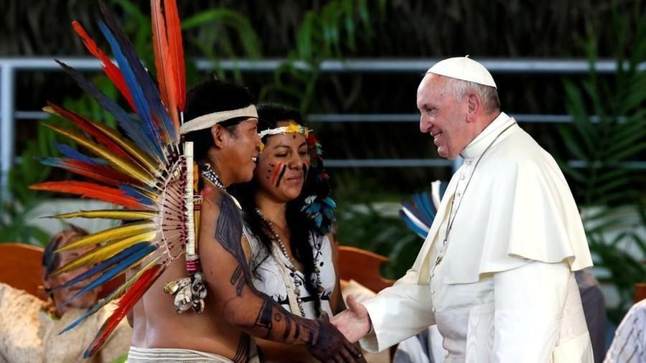
Preaching must become incarnate,
spirituality must become incarnate,
ecclesial structures must become incarnate.
For this reason,
I humbly propose in this brief Exhortation
to speak of four great dreams
that the Amazon region inspires in me. QA 6

Slide 4
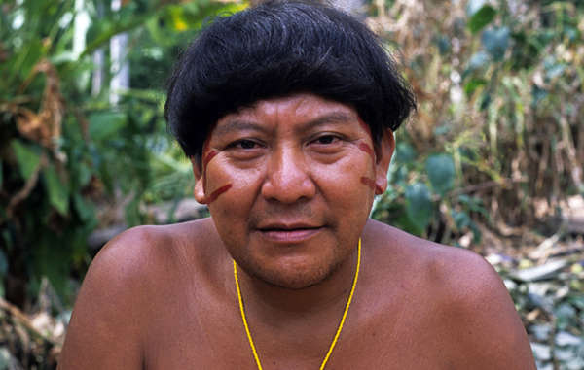
I dream of an Amazon region
that fights for the rights of the poor, the original peoples and the least of our brothers and sisters, where their voices can be heard
and their dignity advanced. QA 7

Slide 5
If we wish to dialogue,
we should do this in the first place with the poor.
They are not just another party to be won over,
or merely another individual seated at a table of equals. They are our principal dialogue partners,
those from whom we have the most to learn,
to whom we need to listen out of a duty of justice,
and from whom we must ask permission before presenting our proposals.
Their words, their hopes and their fears
should be the most authoritative voice
at any table of dialogue on the Amazon region.
And the great question is:
“What is their idea of ‘good living’ for themselves
and for those who will come after them?”
QA 26

Slide 6
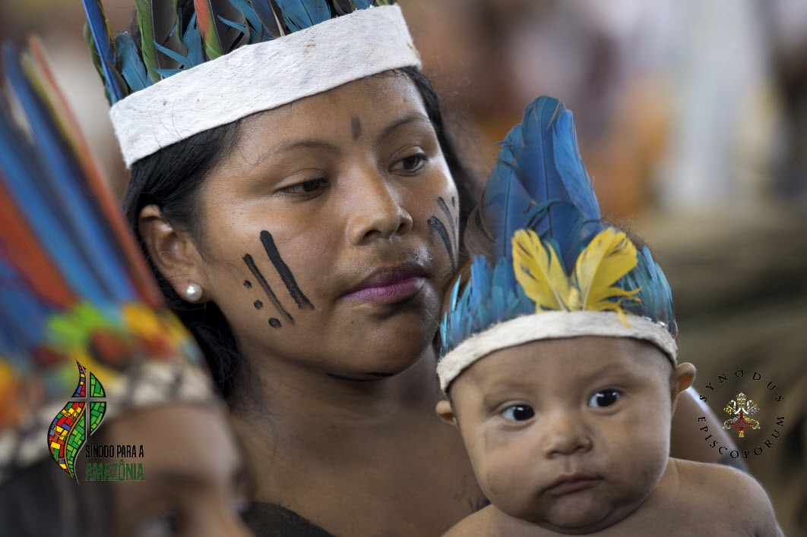
I dream of an Amazon region
that can preserve its distinctive cultural riches, where the beauty of our humanity
shines forth in so many varied ways … QA 7

Slide 7
Even now, we see in the Amazon region
thousands of indigenous communities,
people of African descent, river people and city dwellers, who differ from one another
and embrace a great human diversity.
In each land and its features,
God manifests himself
and reflects something of his inexhaustible beauty.
Each distinct group, then, in a vital synthesis
with its surroundings, develops its own form of wisdom. Those of us who observe this from without
should avoid unfair generalizations, simplistic arguments and conclusions drawn only on the basis
of our own mind sets and experiences.
QA 32

Slide 8
Pope Francis warns against ‘a consumerist vision of human beings, encouraged by the mechanisms of today’s globalized economy’
which ‘has a levelling effect on cultures, diminishing the immense variety which is the heritage of all humanity’
… there is a need to care lovingly for our roots,
since they are “a fixed point from which we can grow and meet new challenges”.
I urge the young people of the Amazon region, especially the indigenous peoples,
to “take charge of your roots,
because from the roots comes the strength
that will make you grow, flourish and bear fruit”.
For those of them who are baptized, these roots include the history of the people of Israel and the Church up to our own day. Knowledge of them can bring joy and, above all, a hope capable of inspiring noble and courageous actions. QA 33

Slide 9
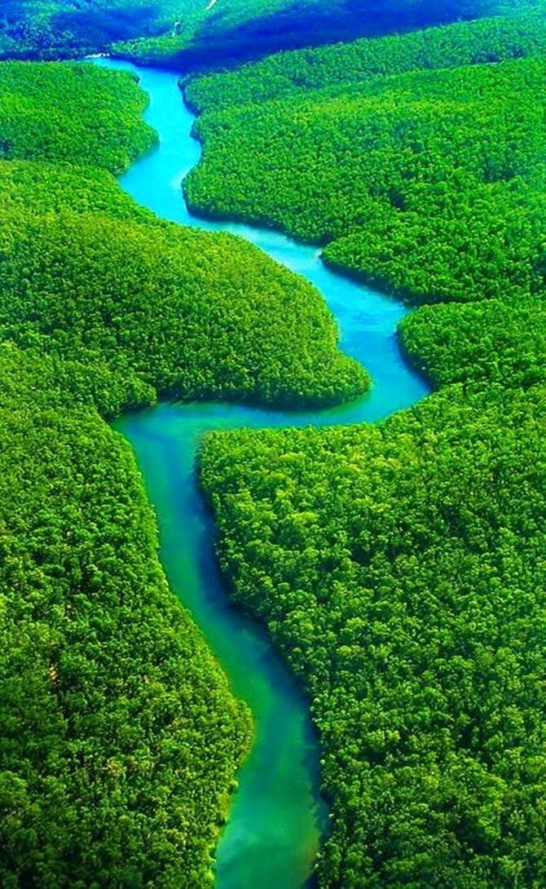
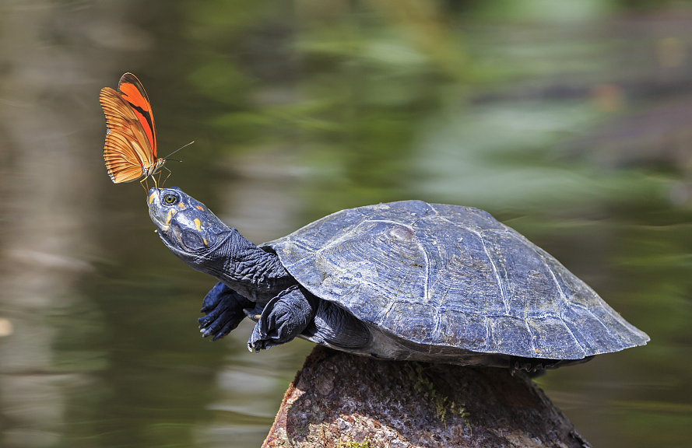
I dream of an Amazon region
that can jealously preserve
its overwhelming natural beauty
and the superabundant life
teeming in its rivers and forests … QA 7

Slide 10
… in an ecosystem like that of the Amazon region, each part is essential for the preservation of the whole.
The lowlands and marine vegetation
also need to be fertilized by the alluvium of the Amazon. The cry of the Amazon region reaches everyone
because “the conquest and exploitation of resources…
has today reached the point of threatening the environment’s hospitable aspect:
the environment as ‘resource’
risks threatening the environment as ‘home’.
The interest of a few powerful industries
should not be considered more important
than the good of the Amazon region
and of humanity as a whole.
QA 48

Slide 11
A lesson each country needs to learn …
It is important that:
‘each government
carries out its proper and inalienable responsibility
to preserve its country’s environment
and natural resources,
without capitulating to spurious
local or international interests” QA 50
Because of us, thousands of species will no longer give glory to God by their very existence,
nor convey their message to us.
We have no such right. QA 54

Slide 12
From the original peoples, we can learn to
contemplate the Amazon region and not simply analyse it,
and thus appreciate this precious mystery
that transcends us.
We can love it, not simply use it, with the result that love can awaken a deep and sincere interest.
Even more, we can feel intimately a part of it
and not only defend it;
then the Amazon region will once more become
like a mother to us.
For we do not look at the world from without
but from within, conscious of the bonds with which
the Father has linked us to all beings. QA 55

Slide 13
Pope Francis speaks of the need to
‘encourage the development of new habits
in individuals and groups.
Sadly, many of those living in the Amazon region
have acquired habits typical of the larger cities,
where consumerism and the culture of waste
are already deeply rooted.
A sound and sustainable ecology,
one capable of bringing about change,
will not develop unless people are changed,
unless they are encouraged to opt for
another style of life, one less greedy and more serene, more respectful and less anxious, more fraternal.’
QA 58

Slide 14
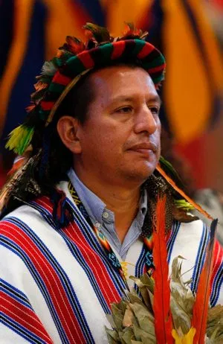
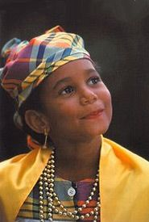
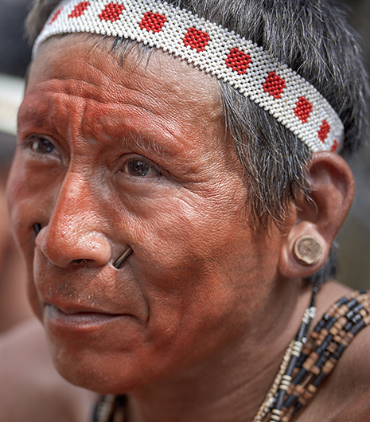
I dream of Christian communities
capable of generous commitment,
incarnate in the Amazon region,
and giving the Church
new faces with Amazonian features …
QA 7

Slide 15
An authentic option for the poor and the abandoned,
while motivating us to liberate them
from material poverty and to defend their rights,
also involves inviting them to
a friendship with the Lord
that can elevate and dignify them.
How sad it would be if they were to receive from us
a body of teachings or a moral code,
but not the great message of salvation,
the missionary appeal that speaks to the heart
and gives meaning to everything else in life.
QA 63

Slide 16
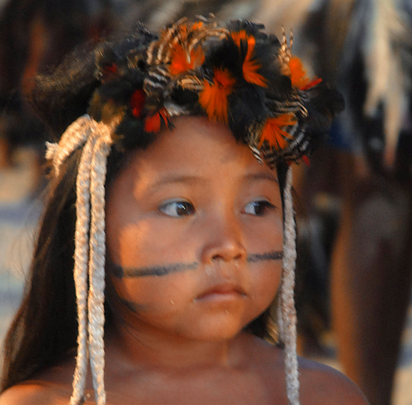
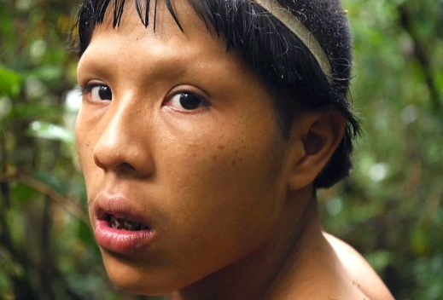
Nor can we be content with a social message.
If we devote our lives to their service,
to working for the justice and dignity that they deserve, we cannot conceal the fact that we do so
because we see Christ in them
and because we acknowledge the immense dignity
that they have received from God,
the Father who loves them with boundless love. QA 63

Slide 17
(the Church) constantly reshapes her identity
through listening and dialogue with the people,
the realities and the history of the lands
in which she finds herself.
In this way, she is able to engage increasingly
in a necessary process of inculturation
that rejects nothing of the goodness
that already exists in Amazonian cultures,
but brings it to fulfilment in the light of the Gospel
QA 66

Slide 18
... Here we see the authentic Tradition of the Church, which is not a static deposit or a museum piece,
but the root of a constantly growing tree.
This millennial Tradition bears witness to God’s work in the midst of his people
and is called to keep the flame alive
rather than to guard its ashes.
QA 66

Slide 19
The Strength and Gift of Women…
The Lord chose to reveal his power and his love through two human faces:
the face of his divine Son made man
and the face of a creature, a woman, Mary.
Women make their contribution to the Church in a way that is properly theirs, by making present
the tender strength of Mary, the Mother …
without women, the Church breaks down,
and how many communities in the Amazon would have collapsed, had women not been there to sustain them, keep them together and care for them.
This shows the kind of power that is typically theirs.
QA 101

Slide 20
The present situation requires us to encourage
the emergence of other forms of service
and charisms that are proper to women
and responsive to the specific needs
of the peoples of the Amazon region
at this moment in history. QA 102
Re-imagining

Slide 21
What is needed is courageous openness
to the novelty of the Spirit,
who is always able to create something new
with the inexhaustible riches of Jesus Christ
... let us be fearless;
let us not clip the wings of the Holy Spirit.
QA 69

Slide 22
Mother of life,
in your maternal womb Jesus took flesh,
the Lord of all that exists.
Risen, he transfigured you by his light
and made you the Queen of all creation.
For that reason, we ask you, Mary,
to reign in the beating heart
of Amazonia.
Show yourself the Mother of all creatures,
in the beauty of the flowers, the rivers,
the great river that courses through it
and all the life pulsing in its forests.
Tenderly care for this explosion of beauty.

Slide 23
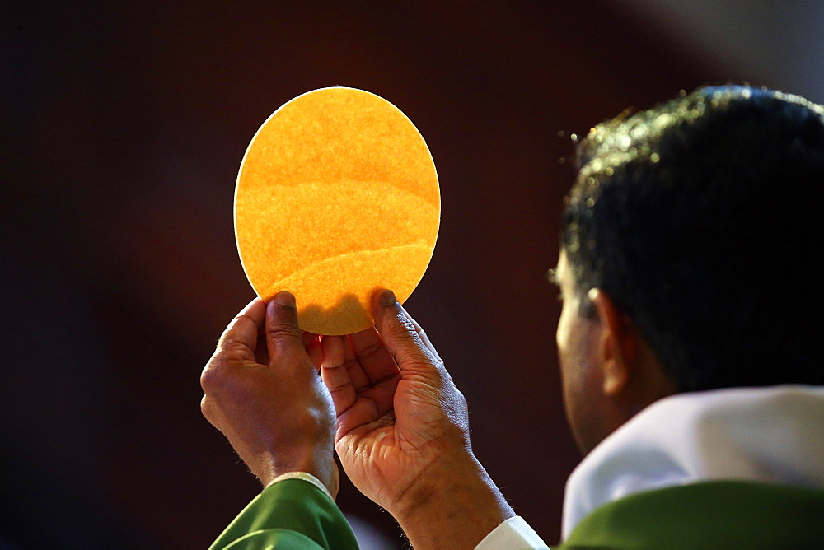
Ask Jesus to pour out all his love
on the men and women who dwell there,
that they may know how to appreciate and care for it.
Bring your Son to birth in their hearts,
so that he can shine forth in the Amazon region,
in its peoples and in its cultures,
by the light of his word,
by his consoling love,
by his message of fraternity and justice.
And at every Eucharist,
may all this awe and wonder be lifted up
to the glory of the Father.

Slide 24
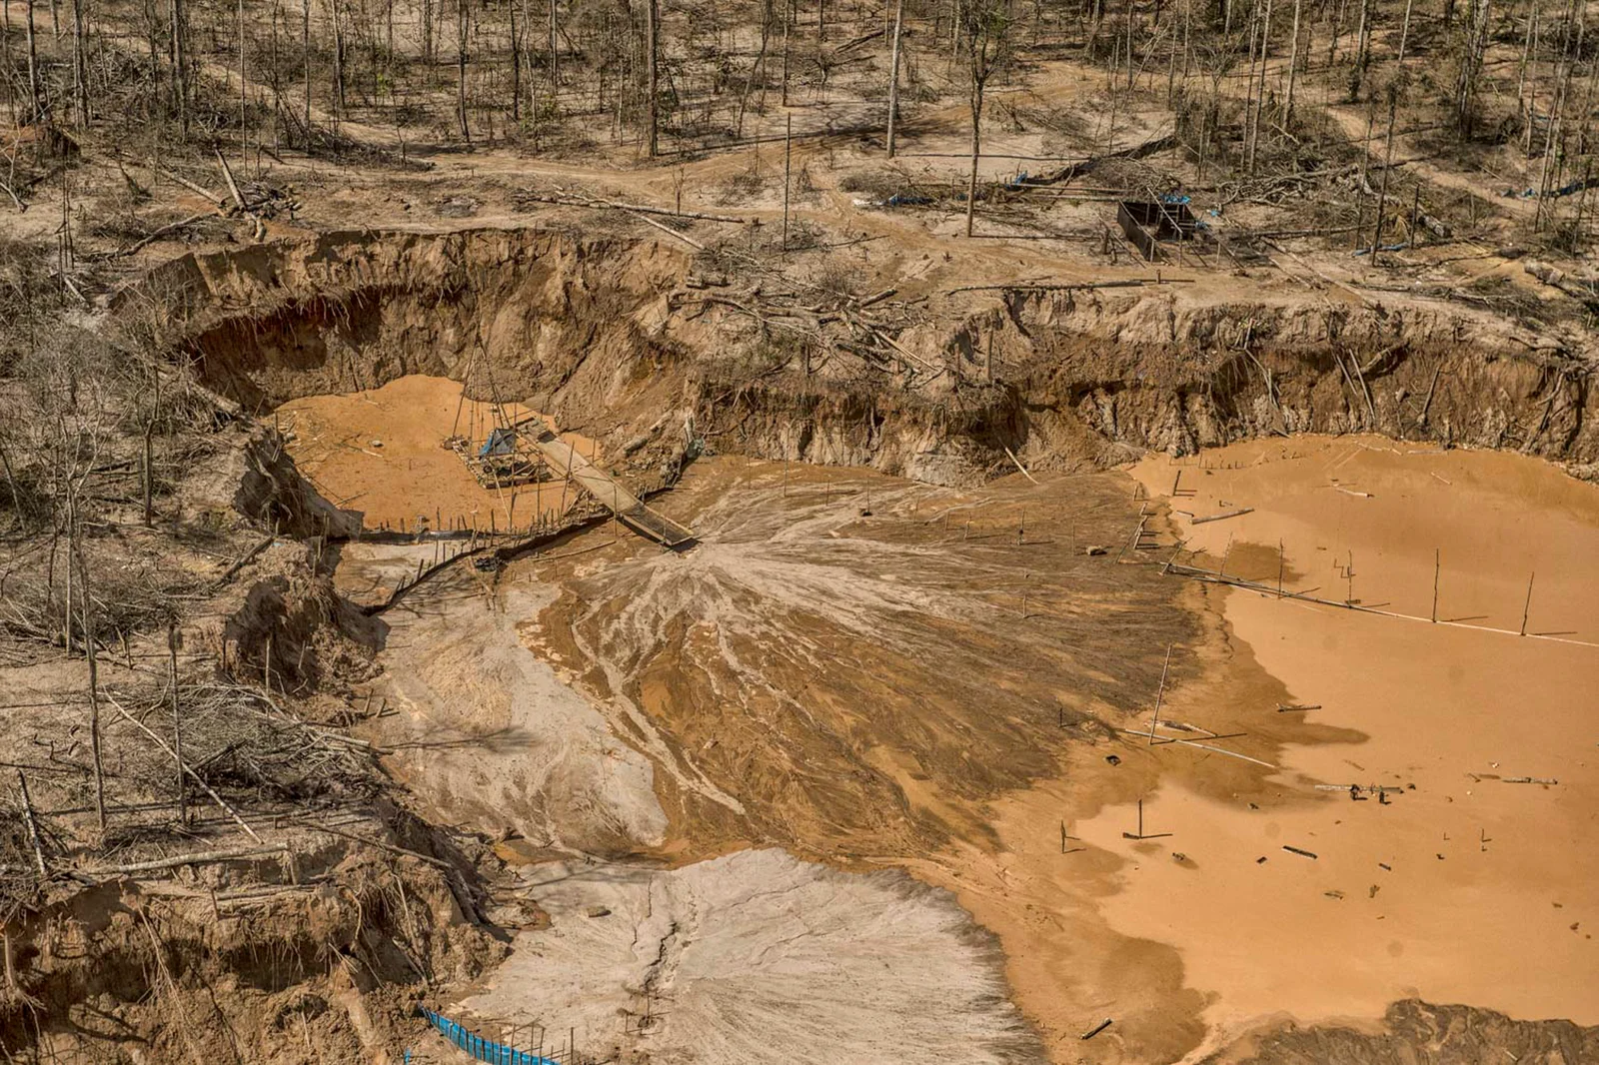
Mother, look upon the poor of the Amazon region,
for their home is being destroyed by petty interests.
How much pain and misery,
how much neglect and abuse there is
in this blessed land
overflowing with life!
Touch the hearts of the powerful,
for, even though we sense that the hour is late,
you call us to save
what is still alive.

Slide 25
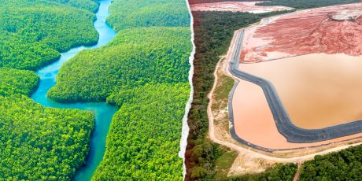
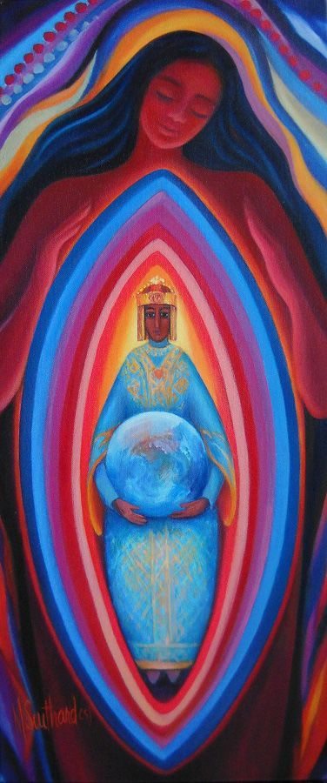
Mother whose heart is pierced,
who yourself suffer in your mistreated sons and daughters,
and in the wounds inflicted on nature,
reign in the Amazon,
together with your Son.
Reign so that no one else can claim lordship
over the handiwork of God.
We trust in you, Mother of life.
Do not abandon us
in this dark hour.
Amen.

